Slide 1
<KEY LOGGER project>
Presented by
SAILESH BABU.c
Anjalai Ammal Mahalingam Engineering College
Information Technology

Slide 2
OUTLINE
Problem Statement
Proposed System/Solution
System Development Approach
Algorithm & Deployment
Result (Output Image)
Conclusion
Future Scope
References

Slide 3
PROBLEM STATEMENT
Creating A Keylogger Can Be Both Intriguing And Educational.
However, It’s Crucial To Approach This Project Responsibly
And Ethically.
Keyloggers Have Legitimate Uses, Such As Monitoring Employee Productivity OrImplementing Parental Controls,but They Can Also Be Misused For Malicious Purposes.
To get started, we’ll build a basic keylogger using the pynput library.Remember that you should only use this knowledge in environments where you have explicit permission to monitorand record keystroke

Slide 4
PROPOSED SOLUTION
Basic Keylogger
Create a simple keylogger that captures all keystrokes (including special keys) and saves them to a log file.Use the pynput library to listen for key events.Save the captured keys to a text file (e.g., “log.txt”).Implement graceful exit (e.g., stop logging when the Escape key is pressed)
Advanced Features
Add timestamping to each logged keystroke.Encrypt the log file for security.Implement remote reporting (send logs to a server or email) for monitoring purposes.
Ethical Considerations
Always use keyloggers responsibly and legally.Obtain proper consent before deploying a keylogger.
Educate users about the purpose and scope of monitoring.
Timestamping
Enhance your keylogger by adding timestamps to each logged keystroke.Use the datetime module to record the exact time when a key was pressed.Include the timestamp in the log file alongside the corresponding key.
Encryption
Consider encrypting the log file to protect sensitive information.Use encryption libraries (e.g., cryptography) to secure the log data.Encrypt the log content before writing it to the file and decrypt it when needed.

Slide 5
SYSTEM APPROACH
Objective: The primary goal of our keylogger is to capture keystrokes made by the user and log them for further analysis or monitoring.
Key Listener:
We’ll use the pynput library to listen for key events (both key presses and releases).
The key listener will run in the background, capturing keystrokes without disrupting the user’s normal activities.
Data Storage:
We’ll save the captured keystrokes to a log file (e.g., “log.txt”).
Each key press will be recorded along with a timestamp (optional).
User Interface (Optional):
We can create a simple command-line interface (CLI) to start and stop the keylogger.
The user can initiate the keylogger and terminate it when needed..

Slide 6
ALGORITHM AND DEPLOYMENT
____________________
Algorithm for Building a Keylogger
Key Listener Setup:
Initialize a key listener using the chosen library (e.g., pynput for Windows, pyxhook for Linux).
Define callback functions for key presses (e.g., on_press) and key releases (e.g., on_release).
Capture Keystrokes:
In the on_press callback:
Capture the pressed key (ASCII value or character).
Handle special keys (e.g., Enter, Space, Backspace).
Append the key to a buffer or log.
Write to Log File:
Implement the write_file function:
Open the log file (e.g., “log.txt”) in “append” mode.
Write the buffered keys to the log file.
Close the file after writing.
Graceful Exit:
In the on_release callback:
Check if the Escape key was pressed.
If so, stop the key listener and close the log file.

Slide 7
Deployment Approach
Local Deployment:
Run the Python script on the local machine where you want to capture keystrokes.
Ensure that the script runs in the background (e.g., minimize the console window).
The keylogger will save all keystrokes to the specified log file.
Executable Creation:
Convert the Python script into an executable (e.g., using tools like pyinstaller or cx_Freeze).
Distribute the executable to target machines.
Users can run the executable discreetly to start the keylogger.
Ethical Considerations:
Always use keyloggers responsibly and legally.
Obtain proper consent before deploying a keylogger.
Educate users about the purpose and scope of monitoring.

Slide 8
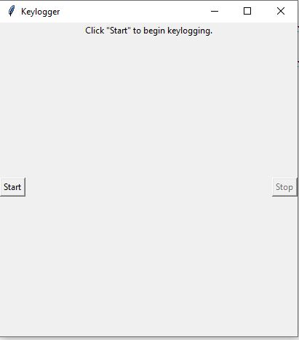
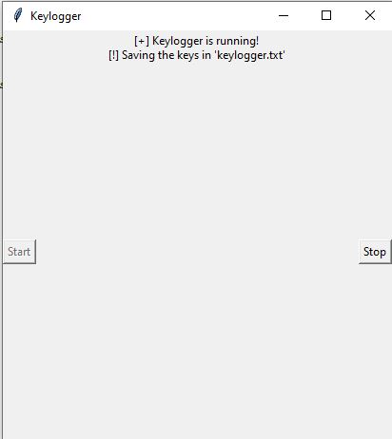
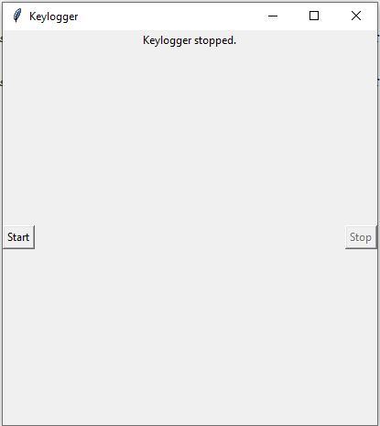
RESULTS
The keylogger runs and saves all keyLogs to “c:\output.txt”.
TO start KEY LOGGER
KEY LOGGER RUNNING
KEY LOGGER TERMINATED

Slide 9
CONCLUSION
our Python keylogger project aims to capture keystrokes on a computer system. It can be used for security, monitoring, research, or educational purposes.
In conclusion, the keylogger project serves as a valuable learning experience,providing insights into cybersecurity, ethical considerations,and the responsible development of monitoring tools.By approaching keylogger development with a commitment to ethics and integrity,
we can harness the potential of such tools while safeguarding privacy and respectingindividual rights.

Slide 10
FUTURE SCOPE
Security and Troubleshooting:
Keyloggers can continue to play a crucial role in troubleshooting technical problems with computers and business networks. They help identify issues related to keyboard input, system behavior, and software conflicts.Keyloggers can be integrated into security systems to detect unauthorized access attempts or suspicious activities. By monitoring keystrokes, they can raise alerts when unusual patterns are detected.
User Monitoring and Productivity:
Organizations can use keyloggers to monitor employee productivity, track work-related activities, and ensure compliance with company policies.
Keyloggers can help parents keep an eye on their children’s online activities, ensuring their safety and responsible internet usage.
Cross-Platform Keyloggers:
Extend keyloggers to work on multiple operating systems (Windows, Linux, macOS, Android, iOS).
Cloud Integration: Store logs securely in the cloud, allowing remote access and analysis.
Machine Learning: Implement machine learning algorithms to detect anomalies or predict user behavior based on keystrokes.

Slide 11
REFERENCES
GeeksforGeeks provides a detailed tutorial on creating a keylogger using Python. It covers capturing keystrokes, saving logs, and handling security considerations.
Design a Keylogger in Python - GeeksforGeeks
Wikipedia’s article on keystroke logging provides an overview of keyloggers, their history, and various applications.
Keystroke Logging - Wikipedia

Slide 12
THANK YOU

